Slide 1
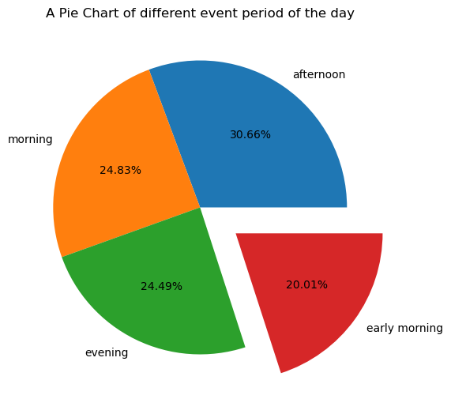
Project Title: Data Science on Subscription Service
OLATOMIWA GRACE OLUWATUNMISE
DATALAB LADIES INTERNSHIP PROGRAM(TEAM ACHIEVER)
APRIL 2023.
GITHUB LINK: www.github.com/OlatomiwaGrace

Slide 2
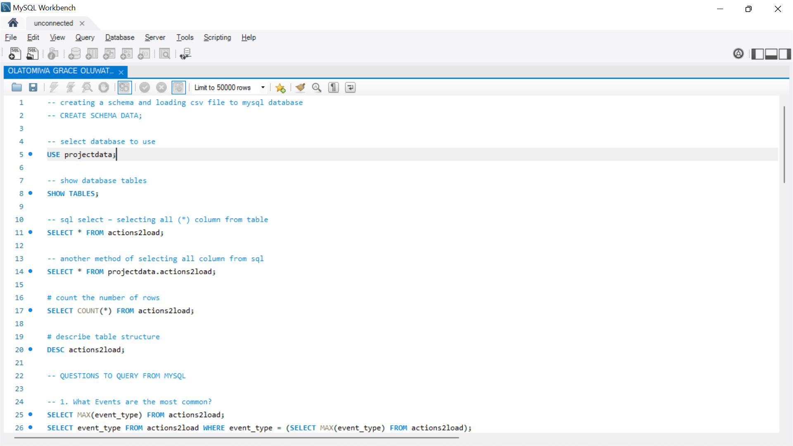
Subscription platform data set and MySQL query
INTRODUCTION: The project worked on is a subscription live book platform in which different people engaged and have different event types happening on it with recorded time of how the event types was engaged. The table by the side shows a brief insight into what the platform looks like and also what is happening on the platform. And the table contains the dataset use in analyzing the subscription platform which is categorical variable dataset.
MYSQL: The first analysis carried out on the dataset was to use MySQL workbench to query the dataset and the following was done: loading the data into MySQL database, checked for the most common events, the least events, the account id with the highest number of events, the account id with the least number of events and the number of times event occurred based on different times of the day.
Part of the query notes screen shot is seen by the side of this write up under the dataset table.
account_id | event_time | event_type | product_id | additional_data
608aa5969cef2edc29cb0c46deaec9da | 10:08.2 | DashboardLivebookLinkOpened | 1156 | /book/learn-dbatools-in-a-month-of-lunches
d07263602248aa70ce1967d6f98f9506 | 10:20.0 | ReadingOwnedBook | 610 | 60s
b7d5902d66127909d0f9d766a841ebb5 | 11:20.7 | ReadingOwnedBook | 1172 | 480s
d07263602248aa70ce1967d6f98f9506 | 11:41.3 | ProductTocLivebookLinkOpened | 1066 | /book/grokking-machine-learning/chapter-1

Slide 3
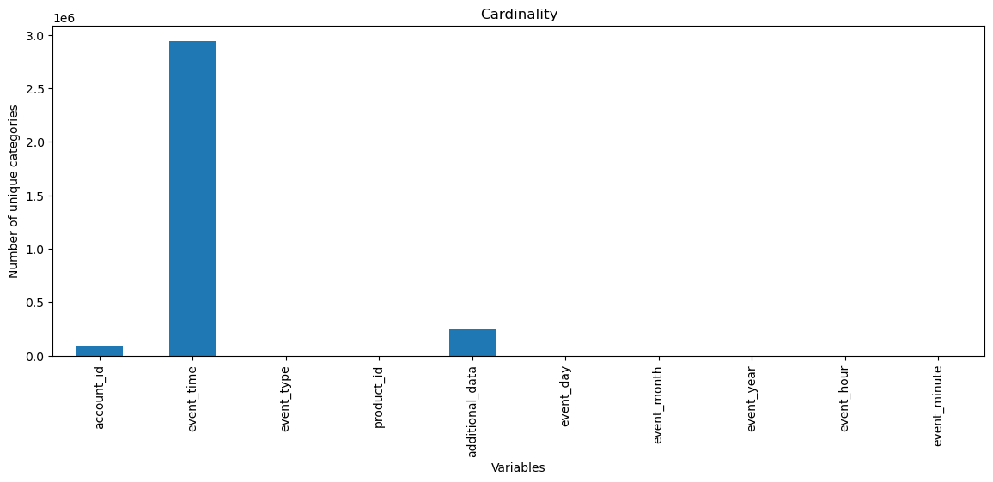
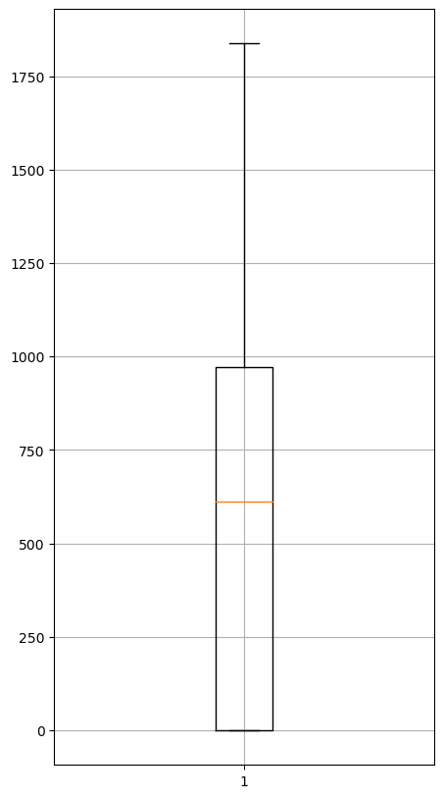
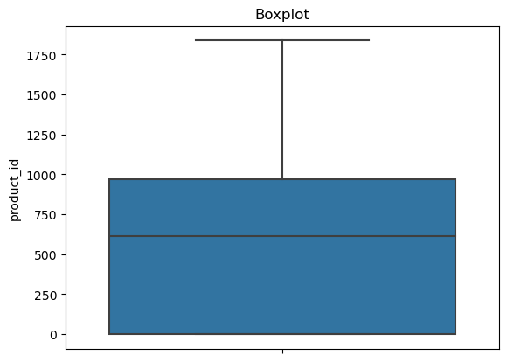
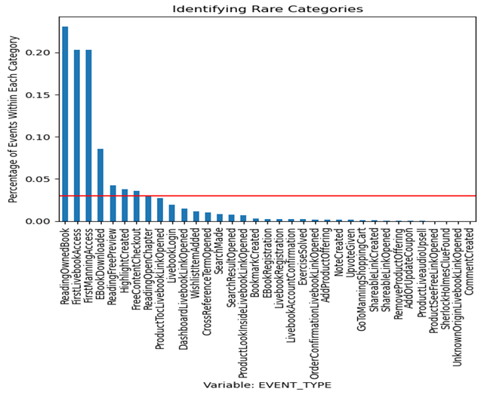
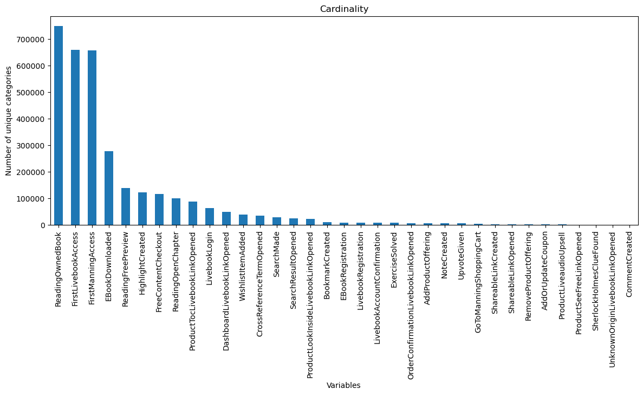
Data preprocessing and exploratory analysis
The dataset was processed by first checking the shape, types, column and missing values in the dataset which serves as a pointer to what need to be done with the data.
Different preprocessing was done which includes: filling the missing values in the additional data column, changing the types of a column, feature engineer more column.
Convert event time to datetime from object types and did feature engineering in event time column to create more columns so as help with further analysis. Other columns added includes year, month, day, hour, week of day etc.
Checked for each of the columns unique variables, determine the cardinality variables in the data set which was uniquely pointed out in event time, also determine cardinality variable in event type and identify rare categories in the event type column, outliers was detected and boxplot was plotted to examine the outliers.
There are class imbalance in the event type which will be work on later in analysis and there are no missing numbers/values in the events column.
Visual representations of some of the work has been presented in the side panel.
Then afterwards exploratory analysis commenced.

Slide 4
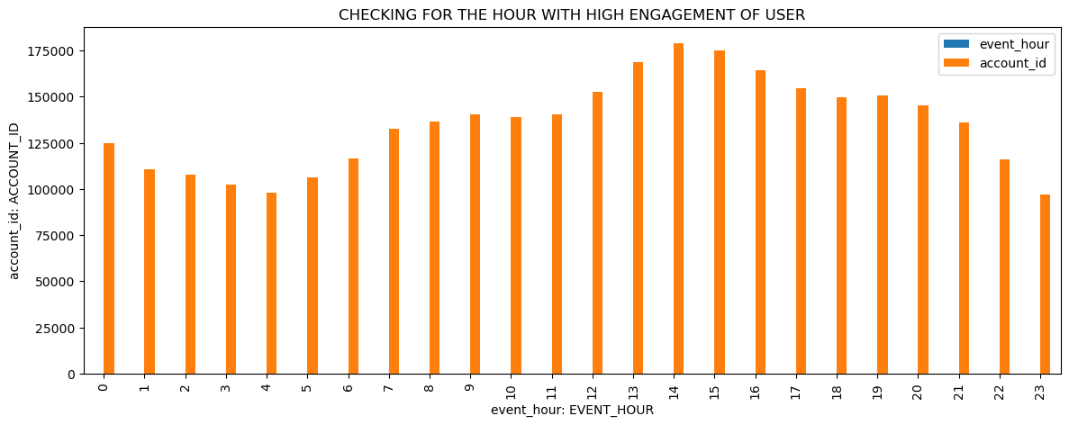
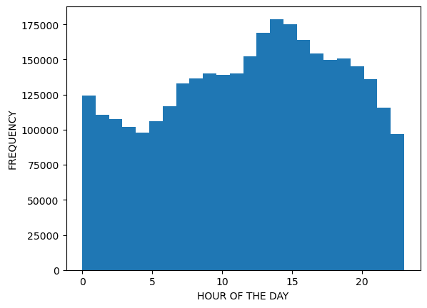
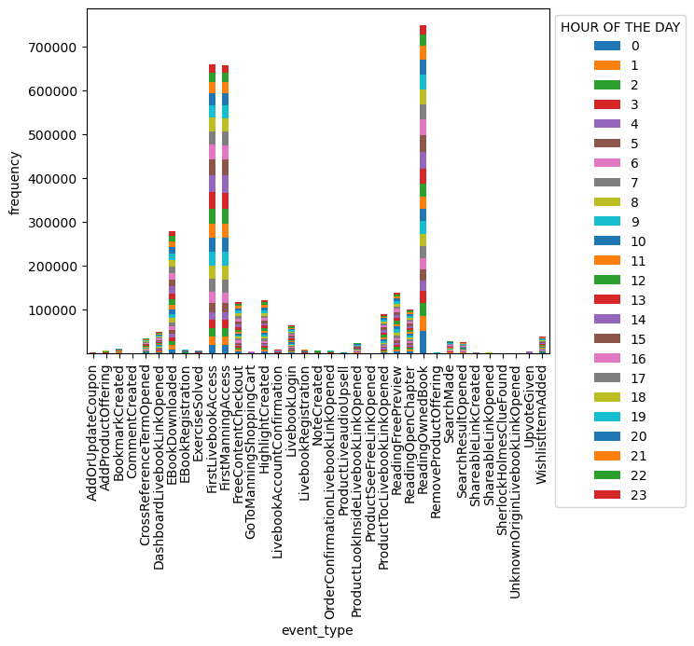
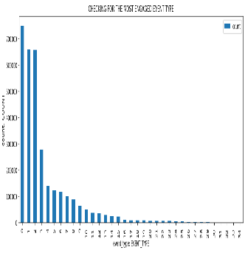
Data preprocessing and exploratory analysis
In the exploratory analysis, there different analysis done on the dataset which are:
Checking if events happen equally at different times of the day or are there patterns in which the analysis shows that there are patterns in which the different event types occur at different times of the day and are represented visually.
Also in the analysis, two different account was analyzed in other to give an insight on how the platform was engaged by the users. Though only one account was required to be analyzed, I had to do two to give more insight on how two different people engaged the platform. The visualization of both account id is shown.
Aside this two analysis, did abit more analysis to help know more about the platform in terms of days, hours, the event type mostly engaged and try to check for relationship between the event type and product id.

Slide 5
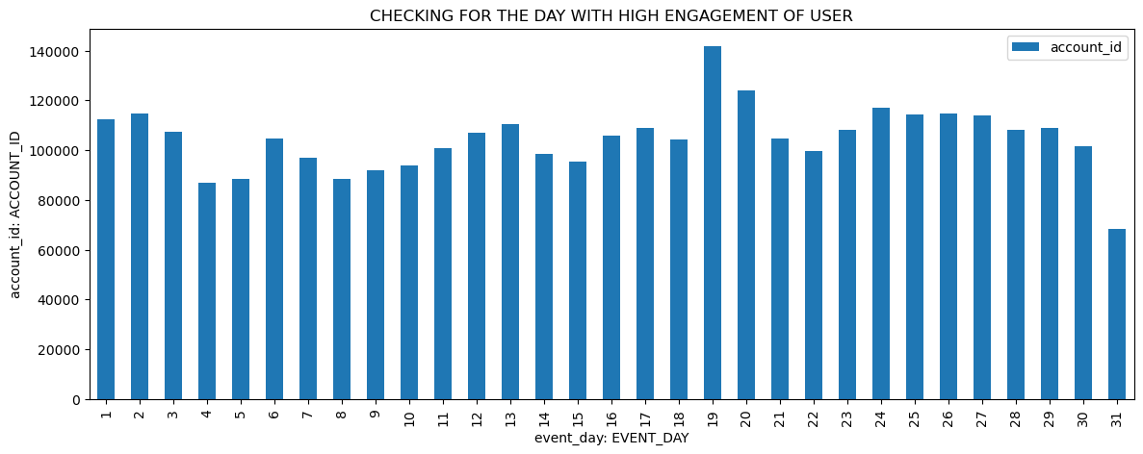
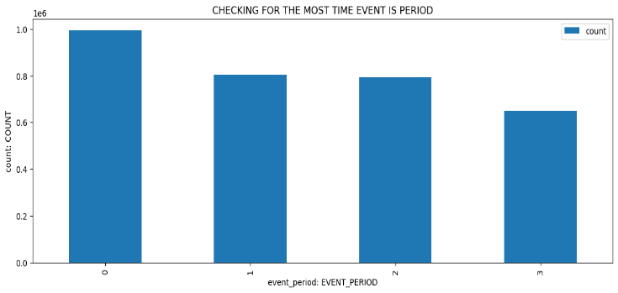
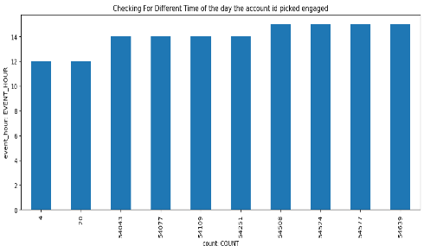
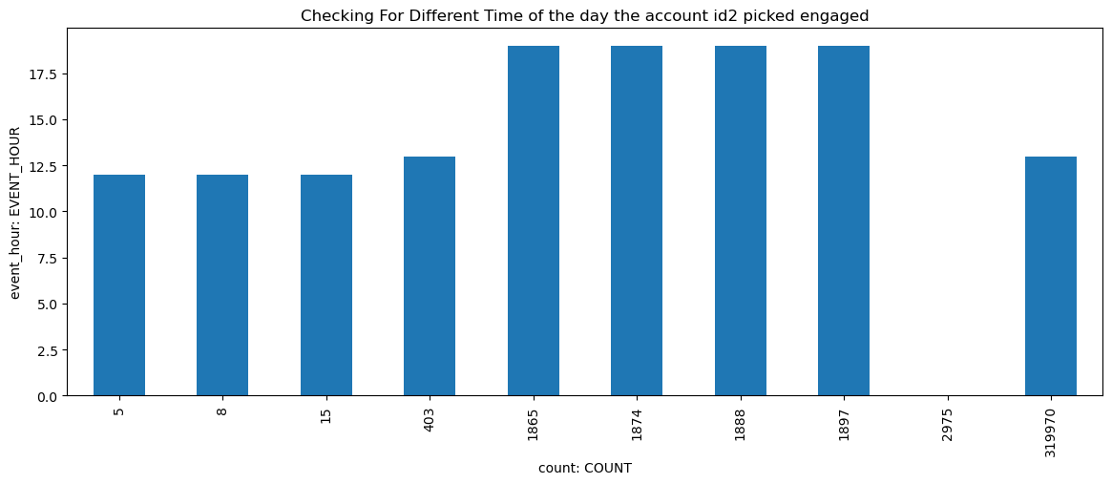
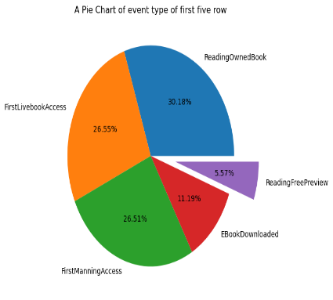

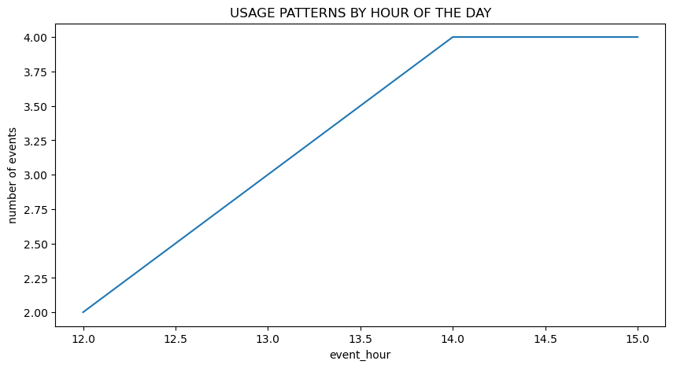
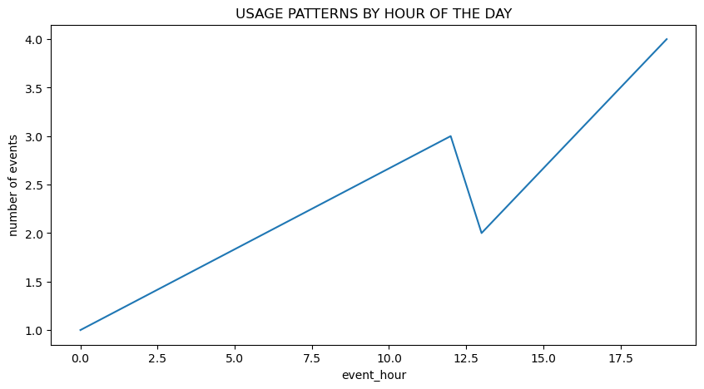
Data preprocessing and exploratory analysis
Here in this slide I will be showing more of visualization done in the analysis, some analysis are represented by line plot, bar chart, pie chart ,histogram and a pivot plot. Two account analyzed have similarities of engaging the platform for 10 times but at different times of the day, different month, and different event types engaged. Also, the two account id have different peaks of the day they make use of the platform, one account id uses it mostly in the afternoon with peaks btw 2pm and 3pm while the other uses it mostly in the evening time with consistency of timing by 7pm.
From the plot of the hour of the day, its shows there are patterns in which different event types occur and most event happen the afternoon with most event type engaged been ReadingOwnedBook.

Slide 6
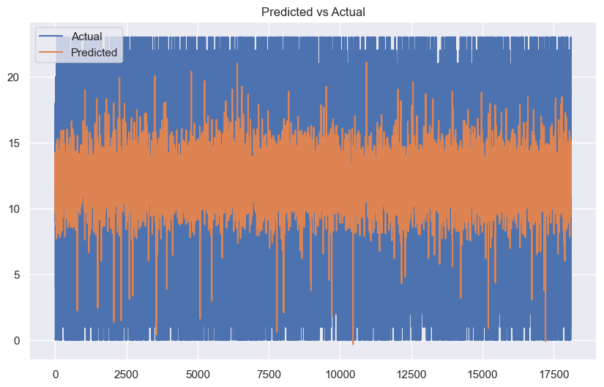
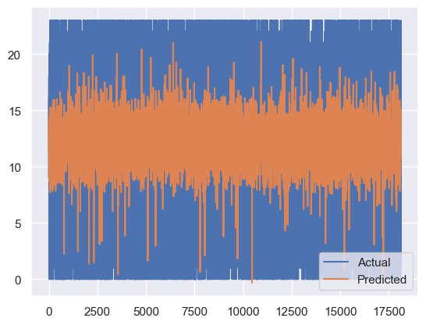
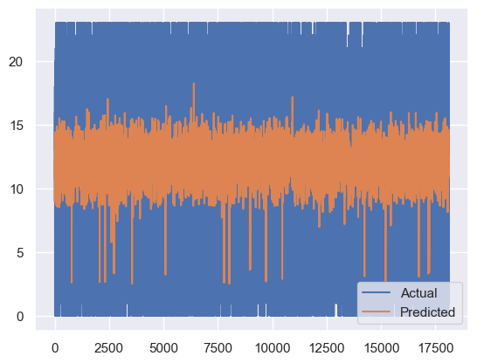
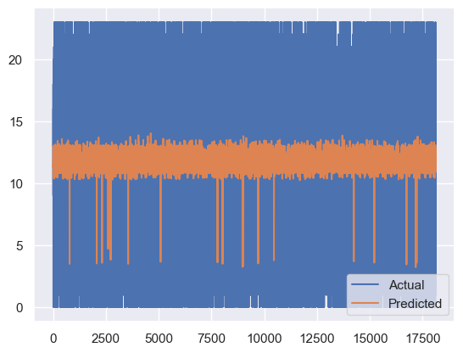
Forecasting Next Event Time with timeseries and ‘XGBOOST’ algorithm
To forecast and predict the next event time, different preprocess had to be done on the dataset, first was to subsample the dataset to a smaller number so that the model will be able to train it, next was to drop all columns not needed for the training. Since the forecasting deals with time, converted the event time to timeseries, did feature engineering on event time to get more time column. Used label encoder to encode the event type column from categorical to numerical variables. Split the data set into train and test, scaled the data, did features importance and decision tree regression, correlation and then train the model using xgboost. The x-axis represent the sample in the test set and the y-axis represent the target variable. The orange color represent the predicted values while the blue color represent the actual values. From the model visuals I can say that the predicted values are close to actual values. After which I up sample the data set cos of imbalance class of event type, then retrain the model, did optimization of the model using randomizedsearchcv and afterwards I did cross validation to know how well the model is preforming using the mean and standard deviation. Then I had to create small data set to predict the next event time with. I analyzed two accounts in which one gave a 1hr different btw previous time and the predicted time while the second one gave a 9hrs difference btw the previous and the predicted.

Slide 7
CONCLUSION AND RECOMMENDATION
The dataset is a categorical variable data which is all about a service subscription engagement platform for books. The dataset was preprocessed, cleansed, analyzed, queried using SQL and then forecasting was done to predict the next event time, the model used for the forecasting is XGBOOST.
In the preprocessing, missing data was filled, cardinality was determined, rare category identified and outliers detected and then proceeded to analysis. The analysis carried out shows there are different patterns in which event occur during the day with most time engaged been in the afternoon with different event types engaged and in between the time of 2pm and 4pm. The most engaged event types was visualized and two account id was analyzed which gave insight on how the account id’s engaged the platform differently at different times and different interest of event types.
The machine learning XGBOOST used to forecast and predict the next event time worked perfectly but decision cant be concluded until other algorithm are been use to train the dataset also for comparison and assurance of results. Though the cross validation result shows its performing well but still recommend more algorithm be used to get different opinions before decision is taken and also I will like to recommend more of timeseries analysis and machine learning be used compare to the method I used which is the convectional way of training any dataset not based on timeseries and I will still work again with timeseries analysis with xgboost and other algorithm to see what the result will be.

